Slide 1
Properties of Solar Wind ULF Waves Associated with Ionospheric Pulsations
A D M Walker, & J A E Stephenson, & S Benz
School of Physics
University of KwaZulu-Natal

Slide 2
We thank:
The ACE instrument and science teams of the MAG and SWEPAM instruments and the Wind MFI and SWI teams for providing the solar wind data.
The National Research Foundation of South Africa (NRF) and the South African Department of Environment Affairs (DEA) for support.
Members of the SSA-MTM team of the Department of Atmospheric Sciences, UCLA and US Geological Survey and the Commissariat `a l’Energie Atomique as well as all other individuals responsible for the development and maintenance of the Toolkit used in the multitaper analysis presented here.

Slide 3
Introduction
Previously we have shown that some Pc5 pulsations observed by SuperDARN radars are driven by solar wind oscillations
We identify several such events in order to study the detailed properties of the solar wind waves
The spectra of the waves are computed using the multiple taper method (MTM)
Correlation between the signals at ACE, WIND, and at the ionosphere is typically significant at the 99% level
Complex demodulation of the filtered spectrum produces a complex analytic signal in the time domain for each observed parameter
From this the polarizations and the energy density and flux vectors of the solar wind waves can be estimated

Slide 4
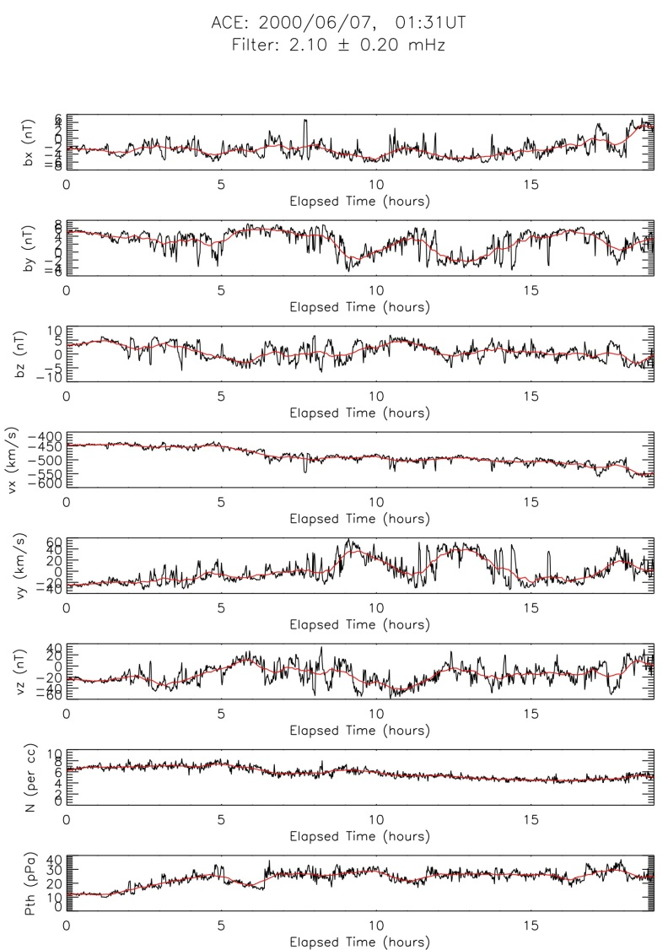
Background Fields
The background fields are estimated using a boxcar integration

Slide 5
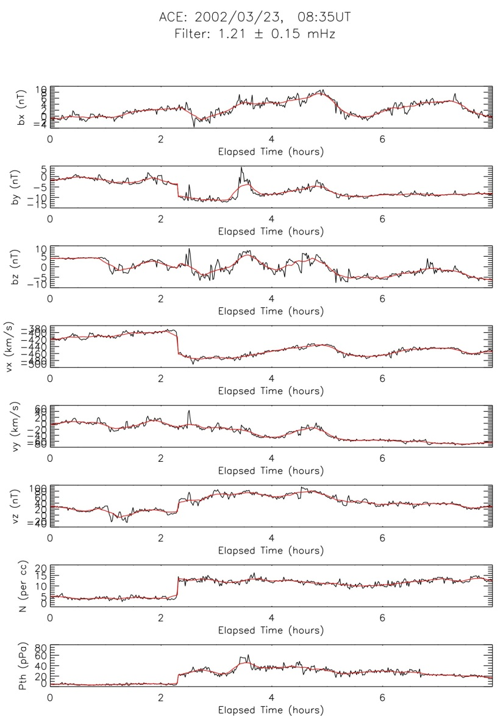
Discontinuities
If there is a significant discontinuity a piecewise boxcar integration is performed

Slide 6
Field aligned coordinates
If $\hat{μ}$ is a unit vector along ${\text{B}}_{0}$ and $\hat{x}$ a unit vector pointing from Earth to Sun then the $\hat{φ}$ direction is $\hat{μ}×\left(\hat{x}×\hat{μ}\right)$ and the $\hat{ν}$ direction is given by $\hat{x}×\hat{μ}$
$\hat{μ}$, $\hat{ν}, \hat{φ}$ form a right handed set of local coordinates
The orientation changes with the background magnetic field on a time scale long compared with the periods of interest.
Once $B_{0}$ has been found ACE and Wind field components are transformed to these coordinates for some purposes
The waves in the solar wind are of MHD type and their polarizations are best expressed relative to field aligned coordinates.

Slide 7
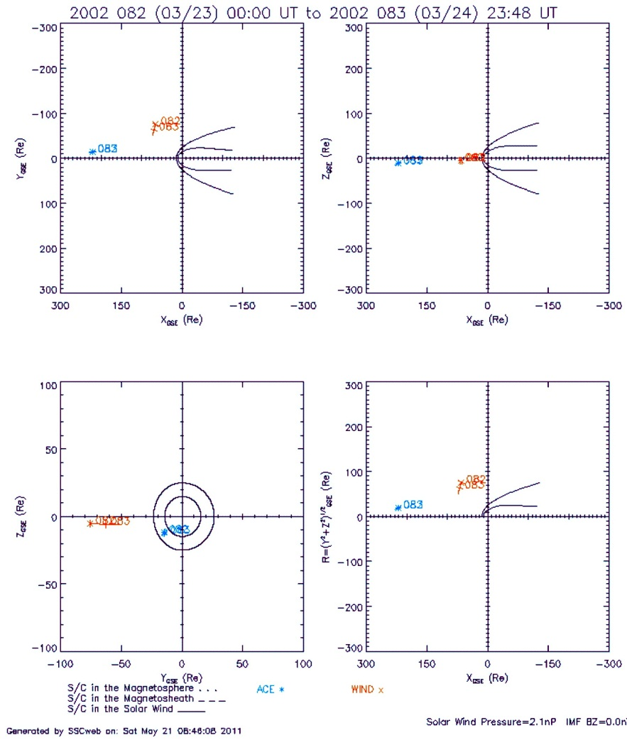
Event of 23rd March 2002
ACE at was at the Solar Libration Point
WIND was nearer Earth, upstream from the bow shock and about $−$60 $R_{E}.$
Wave activity was found in the 1.2mHz and 2.2mHz bands associated with Field line resonances observed with the Sanae Radar

Slide 8
Sanae – 23rd March 2002
Sanae showed small pulsations during the period 08:00 – 16:00 with frequencies centred on 1.2mHz and 2.1mHz
These were significant at the 99% level and were correlated with oscillations in ACE and Wind

Slide 9
23rd March 2002 – Spacecraft Data
Raw data with background field superimposed.
Note the strong discontinuity in $v_{x}$ and other components

Slide 10
Nature of discontinuity
Four possible types of discontinuity
Contact: B continuous across boundary– Reject
Tangential: Normal V and B zero – Reject
Rotational: Density must be continuous – Reject
Shock: Possible
The time delay between discontinuity occurrence at ACE and Wind gives the x component of its velocity as 475 km/s almost as if it were at rest in the faster flow.
Shock velocity should be larger than any flow velocity but this is possible if plane of shock is oblique.
Conclude that this is probably an MHD shock

Slide 11
ACE< 23rd March 2002 – Zero order plasma parameters

Slide 12
Spectrum $B_{ν}$ – 23rd March 2002
ACE – locally white noise
Wind – locally white noise

Slide 13
Spectra $V_{ν}$ - 23rd March 2002
ACE – locally white noise
Wind – locally white noise

Slide 14
Filtered time series – 1.2 Mhz
ACE
Wind

Slide 15
23rd March 2002 – 1.2mHz
ACE – Energy density
Wind – Energy Density

Slide 16
Energy flux in plasma rest frame – 23/3/02
ACE: 1.2 mHz
Wind: 1.2 mHz

Slide 17
Some Conclusions about Event 23rd March 2002
An MHD shock arrived at ACE at 10:47 UT
It was followed by an increase of MHD wave activity at1.2mHz and 2.1mHz.
The system arrived at WIND at 11:22 UT
There is evidence that the waves were transverse Alfvén waves
Pc5 activity were observed by the Sanae radar at these frequencies during this time

Slide 18
General comments
The class of pulsations that appear to be driven by solar wind MHD waves is difficult to pin down.
Often they are small in az noisy background and a careful analysis has to be carried out to ensure the significance of the results.
We are engaged in a program to try and follow the propagation from solar wind through bow shock and magnetosheath but expect progress to be slow – ideally one would like simultaneous observations from spacecraft in the solar wind and in the magnetosheath, as well as from a number of SuperDARN radars to determine the global extent.

Slide 19
We thank:
The ACE instrument and science teams of the MAG and SWEPAM instruments and the Wind MFI and SWE teams for providing the solar wind data.
The National Research Foundation of South Africa (NRF) and the South African Department of Environment Affairs (DEA) for support.
Members of the SSA-MTM team of the Department of Atmospheric Sciences, UCLA and US Geological Survey and the Commissariat `a l’Energie Atomique as well as all other individuals responsible for the development and maintenance of the Toolkit used in the multitaper analysis presented here.

